Slide 1
Text Classification using Zero-Shot Learning Technique
Presented by
Rama Krishna Mullapudi

Slide 2
Zero-Shot Learning
Zero-Shot Learning(ZSL) is referred to a specific type of task in which a classifier is trained on one set of labels and then evaluated on different set of labels that the classifier has never seen before.
Whenever the model is trained on a task it takes in two sequences and determines whether they contradict each other or support each other
ZSL first maps instances to intermediate attributes, which can be seen classes, human-specified or data-dependent attributes. Then the predicted attributes are mapped to a large no of unseen classes.

Slide 3
Natural Language Processing Model
Text classification works based on Natural Language Interference technique by setting up premise and hypothesis.
The model works by generating a score depending on the relationship between premise and hypothesis.
The model assumes by default that the one of the hypothesis is true and gives score which add up to 1.

Slide 4
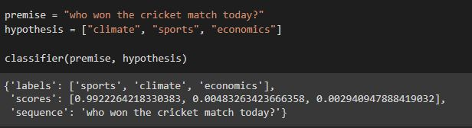
The text we want to classify is given in the premise whereas the labels to which we want to classify the text into is given in the hypothesis.
The classifier compares all the labels present in the hypothesis and scores them that are closely related to the premise.
By default, In zero-shot pipeline the overall score for each label(Hypothesis) will add up to 1.

Slide 5
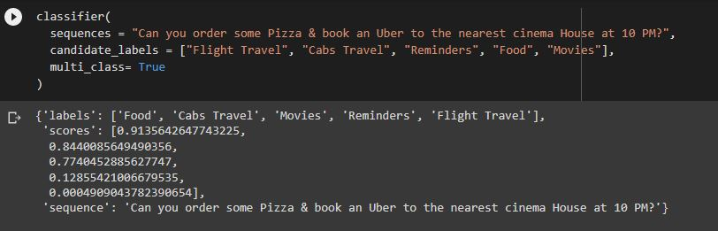
Multiclass classification
Using Zero-Shot pipeline technique we can also achieve Multiclass classification.
To do a Multiclass Classification we just have to pass the command multi_class = True as shown in the picture.
In Multi Class classification, the scores will be independent, but each score will be between 0 and 1.

Slide 6
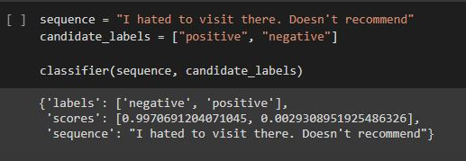
Sentiment Classification
Using Zero-shot learning technique it is also possible to do sentiment classification.

Slide 7
Advantages of Zero-Shot Pipeline
In Zero-shot pipelining we can define our own labels and run the classifier to assign a probability to each label.
We can do Multi-class classification and sentiment detection using Zero-shot pipelining technique.
This technique can be applied on both Annotated and non-annotated data.
ZSL can reduce training and help systems be accurate when confronted with unexpected data.

Slide 8
Conclusion
The Zero-Shot learning method is related to human vision in many ways. Instead of performing classification or recognition on a limited set of objects or data, using Zero-Shot Learning it is possible to classify or recognize every object.
Unsupervised text classification with zero-shot model allows us to solve text sentiment detection tasks when you don’t have training data to train the model.
For specialized use cases, when text is based on specific words or terms — is better to go with a supervised classification model, based on the training set.

Slide 9
Thank you

